Slide 1
OKLAHOMA MEDICAL/HEALTH RESPONSE TO A NEW MADRID EARTHQUAKE
Michael Murphy, EMT-P, M.S.
MMRS Director
Emergency Medical Services Authority
April 26, 2012

Slide 2
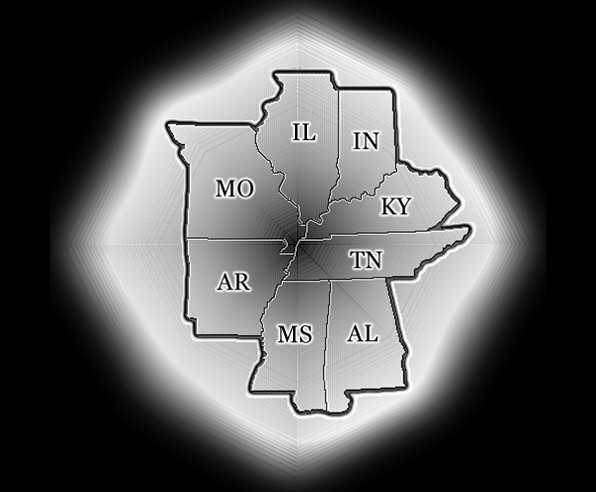
New Madrid Impact States

Slide 3
Objectives
Understand the complexity involved when formulating plans or a response to an incident
Understand key components of a successful response—and forces aligned to thwart
Understand the dual nature of Oklahoma’s response role
Understand the unique resources that may be offered by Oklahoma.

Slide 4
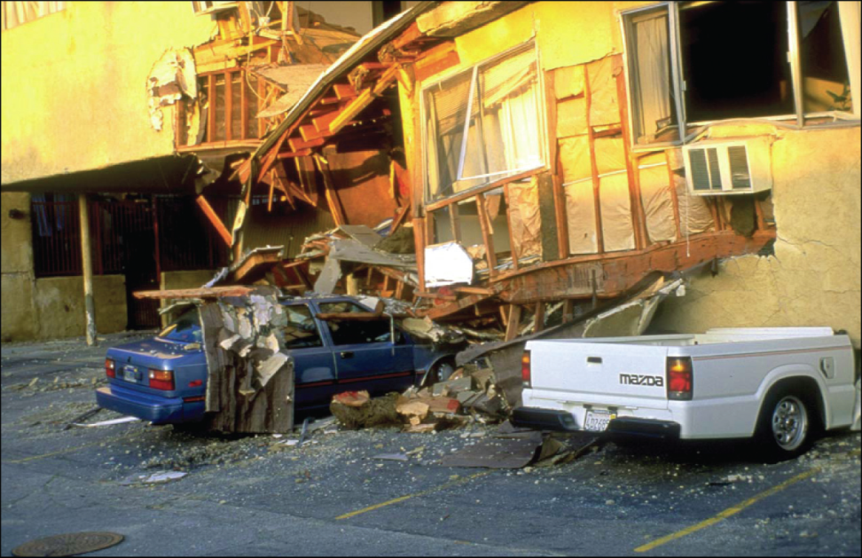
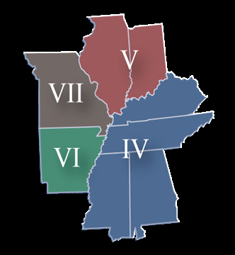
Planning: Not that Simple
Potentially Catastrophic Event:
  Sudden-24/7/365
  On-going (aftershocks)
  Huge Geographic Area Affected
  Potentially Affect all Aspects of Life
  Infrastructure Damage Dictates Response
  Planning “Assumptions”

Slide 5
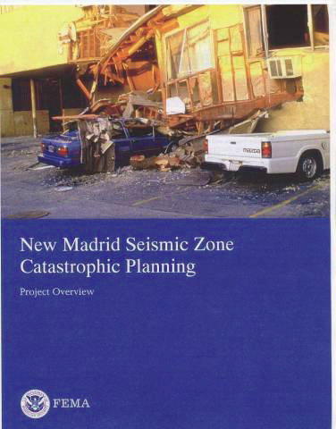
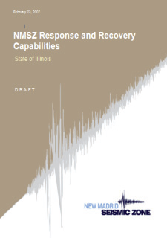
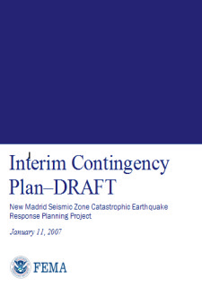
But Quite a Bit Done…
Active planning and research for decades:
  FEMA
  Corps of Engineers
  Federal Agencies
  Academia
  State Governments
  Local Governments

Slide 6
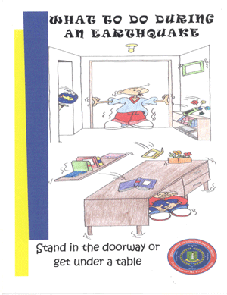
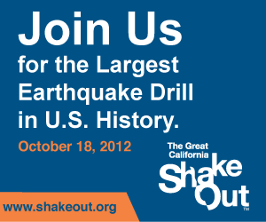
Focus on Mitigation
Mitigation: Steps taken to eliminate risk or reduce the consequences of an incident
  Drills/Education
  Construction Codes
  Retro-fitting
  Research

Slide 7
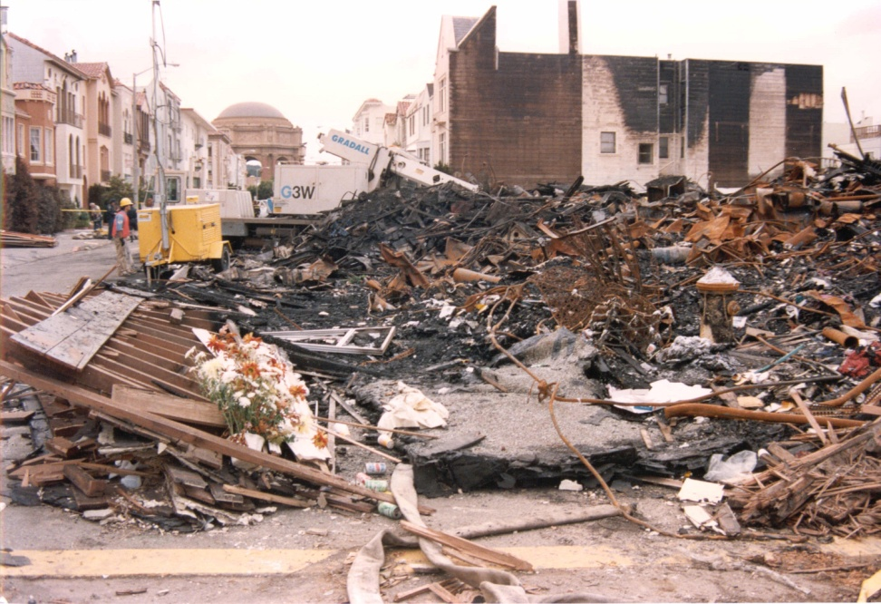
RULE #1: Impact or Not?
WE Might Need Help
If Oklahoma suffers any damage from the earthquake, the state will be considered an impact state and NOT a support state
Resources from impact state are kept to assist local response

Slide 8
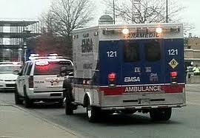
RULE #2 No Self-Dispatch
Oklahoma resources will not “automatically” respond to any damage area (not officially).
Self-dispatched units can create a situation where needed resources aren’t requested. (Joplin)

Slide 9
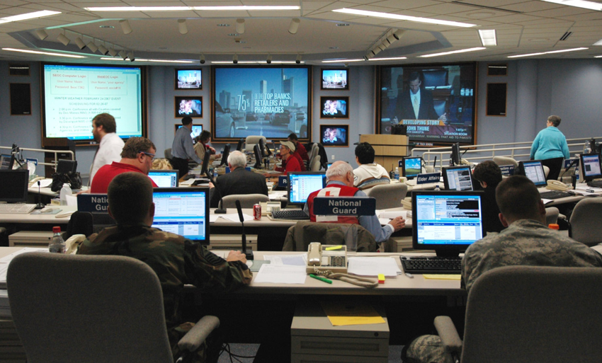
RULE #3 It Will Need to Take Time and Restraint
TOO MUCH TIME….
Need to Assess and come up with a game plan.
Patience, Situational Awareness, and Intelligent Resource Application will win the day

Slide 10



RULE #4 Restraint Won’t Happen
“DO Something….”
Unfortunately, several forces will come into play to destroy this process.
  Sense of urgency/crisis
  Uncontrolled response
  Media
  Public Safety
  Politics

Slide 11
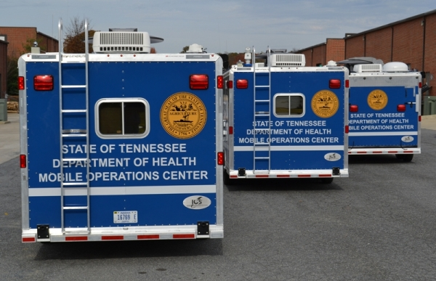
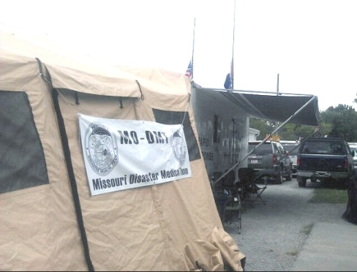
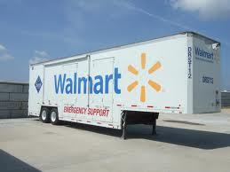
Rule #5 Locals Have Stuff—Lots of Stuff
Impact States have been aware of risk for sometime.
Equipment Caches and specialized equipment exists in region.
Caches located in-state but out of impact area.

Slide 12
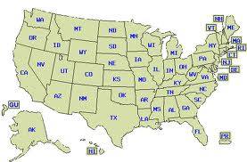
Rule #6 There are Others Out There……
41 other states and the federal government willing and able to provide support
EMAC process used for state-to-state sharing of resources—slow
Oklahoma has the advantage/disadvantage of being close

Slide 13
EMAC
Emergency Management Assistance Compact
Means for States to obtain resources from other States.
Methodical and Slow (see Rule #3)—contract between two states and outlines use, conditions, and return of resources.

Slide 14
EMAC
Emergency Management Assistance Compact
Means for States to obtain resources from other States.
Methodical and Slow (see Rule #3)—contract between two states and outlines use, conditions, and return of resources.
Tends to be too slow on occasion (see Rule #4)—assets used by other means
Bidding Process for EMAC—can be frustrating

Slide 15
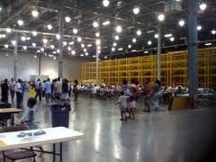
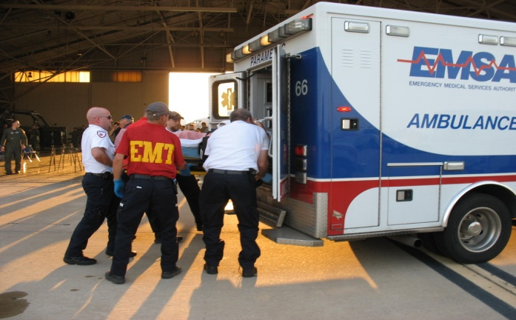
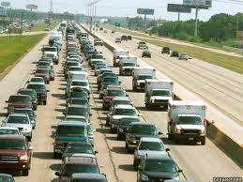
Rule #7 May be Better to Receive than to Give
Real possibility of a mass migration of both evacuees and patients
Infrastructure Disaster Over There……..
Humanitarian Disaster Here……

Slide 16
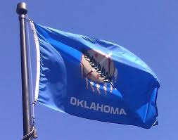
So….What is Oklahoma’s Medical/Health Plan?
Assess Impact to State
Situational Awareness to and from the Medical/Health System
Resource Assessment (on-going)
Capacity Assessment (on-going)
Solid Communication Lines with Feds and Impacted States
Provide/Request Resources via EMAC or Stafford Act

Slide 17
So….What is Oklahoma’s Medical/Health Plan?
In Other Words: “IT DEPENDS”

Slide 18
So….What is Oklahoma’s Medical/Health Plan?
In Other Words: “IT DEPENDS”
  Immediate Impact to the State of Oklahoma..Is there damage?

Slide 19
So….What is Oklahoma’s Medical/Health Plan?
In Other Words: “IT DEPENDS”
  Immediate Impact to the State of Oklahoma..Is there damage?
  Potential Impact from Reception of Evacuees and Patients—How many are coming?

Slide 20
So….What is Oklahoma’s Medical/Health Plan?
In Other Words: “IT DEPENDS”
  Immediate Impact to the State of Oklahoma..Is there damage?
  Potential Impact from Reception of Evacuees and Patients—How many are coming?
  Resource Availability

Slide 21

So….What is Oklahoma’s Medical/Health Plan?
In Other Words: “IT DEPENDS”
  Immediate Impact to the State of Oklahoma..Is there damage?
  Potential Impact from Reception of Evacuees and Patients—How many are coming?
  Resource Availability
  Requests for Resources Via EMAC and/or Federal Government

Slide 22
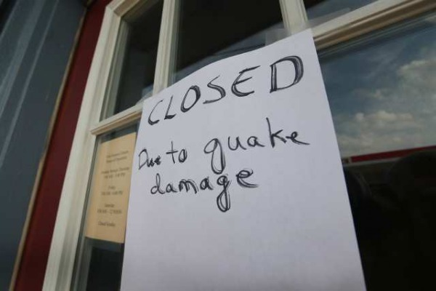
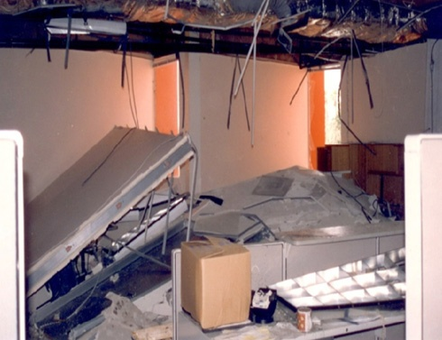
So..If We Can Help--How?
Air Assets
Experienced Personnel
Intact Infrastructure/Money
Intact Medical System
Communication and Coordination System
Response Teams
Hard Assets: Regional Response System

Slide 23
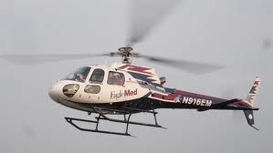
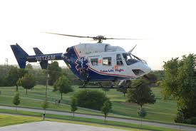
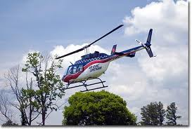
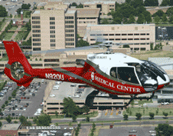
Air Assets
Observation/Assessment
Rescue
Patient Treatment
Patient Movement

Slide 24
Experienced Personnel
Oklahoma “enjoys” a rather large cadre of personnel that have experienced the rather challenging process of managing a disaster….
Personnel can be sent to assist an impact state or, just as importantly, stay in Oklahoma to manage an effective support role.
Oklahoma also has a group of medical and public health professionals that have deployed to assist other areas in crisis in the past.

Slide 25



Intact Infrastructure/Money
Oklahoma will likely have an intact infrastructure—something hard to find to the east of the state.
Oklahomans have traditionally been very generous with donations to support agencies

Slide 26
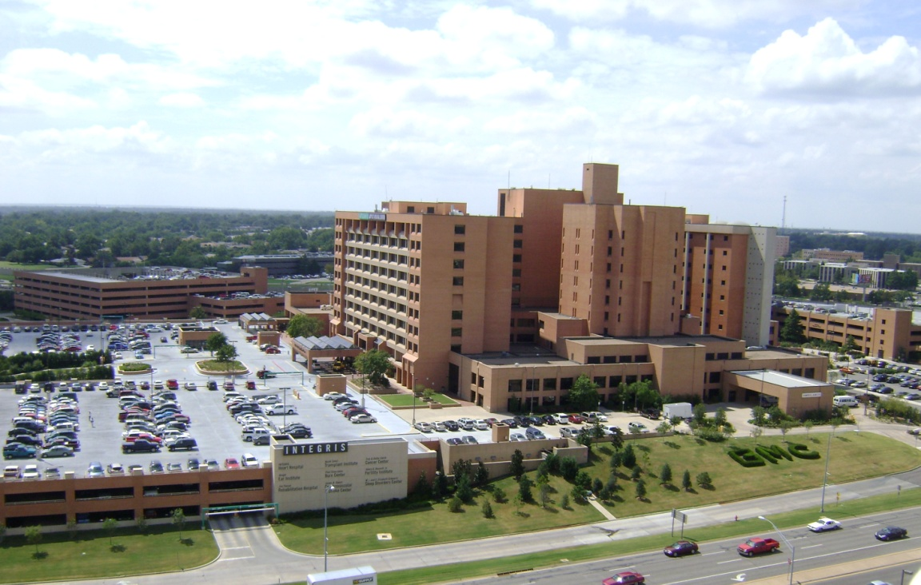
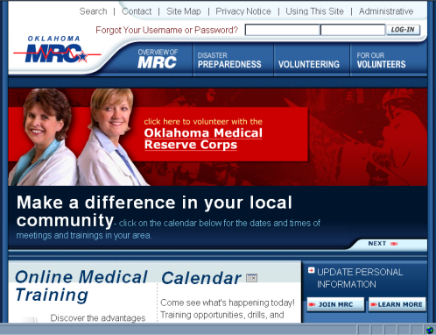
Intact Medical System
Oklahoma will likely also have an intact medical system that may become heavily utilized. Specialty services will be available to assist referred patients.
OKC is an NDMS City with 200-250 NDMS beds.
OKMRC with 3000 members

Slide 27
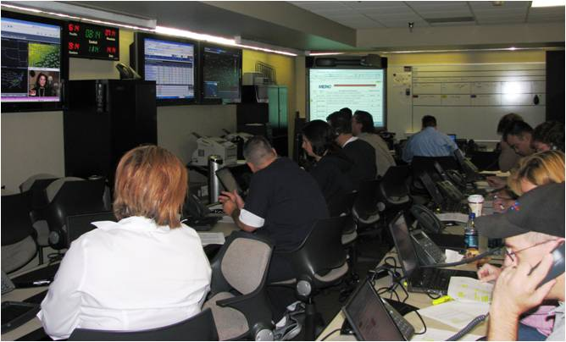

Communication and Coordination Systems (RMRS)
The Regional Medical Response System (RMRS)
Medical Emergency Response Centers (MERC)
Situation Room-OSDH
MACC

Slide 28
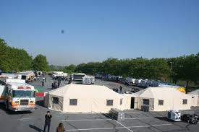
Hard Assets: OSDH/RMRS
  Western Shelter System
    Build 200 bed field hospital
  Generators
    70kw on trailer
  Water Purification
    1 large
    2 small
  Mass Fatality
    MERC System
    (1) Semi-Trailer
    (2) Trailers- 28 bodies

Slide 29
Hard Assets: Regional Response System (OKOHS)
SUSAR
CBRNE Response
Mass Decontamination
Technical Rescue Units
Mass Casualty Trailers
Technical Rescue Trailers
Agricultural Response Trailers
Command Trailers
REMSS Large Trailers
REMSS Medium and Bantam Trailers

Slide 30
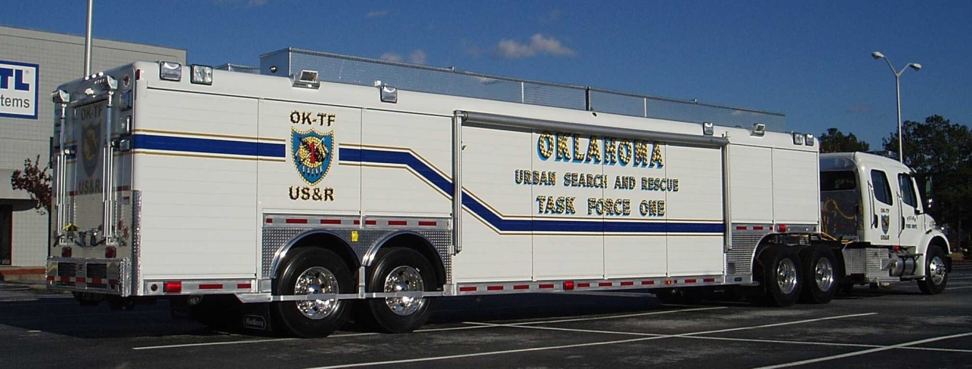
Hard Assets: Regional Response System (OKOHS)
State Urban Search and Rescue (SUSAR)
2 units (OKC/Tulsa)
Identical to FEMA USAR
  3 quad 4x4 trucks 1 ton
  Bobcat
  Trailer

Slide 31
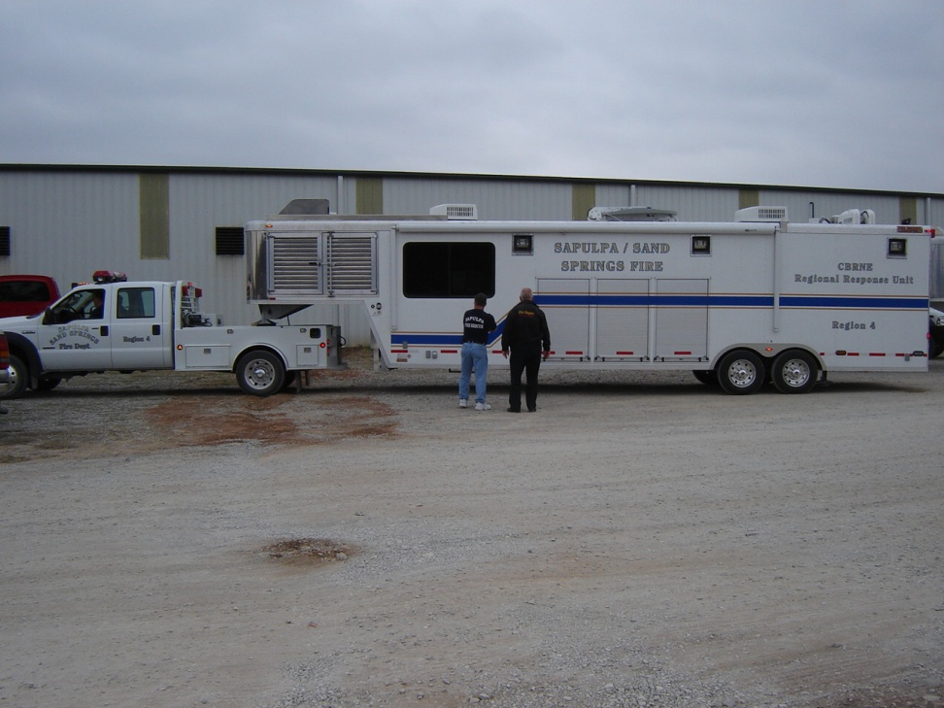
Hard Assets: Regional Response System (OKOHS)
(13) Intermediate CBRNE Trailers:
  Command Center
  Haz-Mat Mitigation
  Light Tower
  Generators
  Satellite Commo

Slide 32
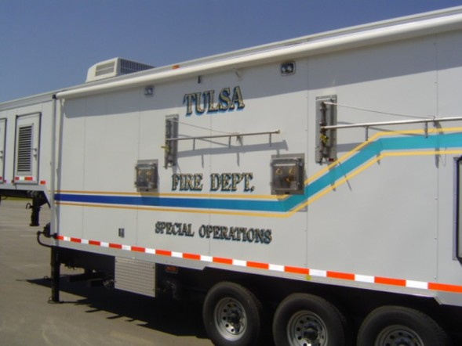
Hard Assets: Regional Response System (OKOHS)
(2) Mass Decontamination Units
  Decon Showers/Hot Water
  Rehab Support
  Medical Support
  Staging Area Support

Slide 33
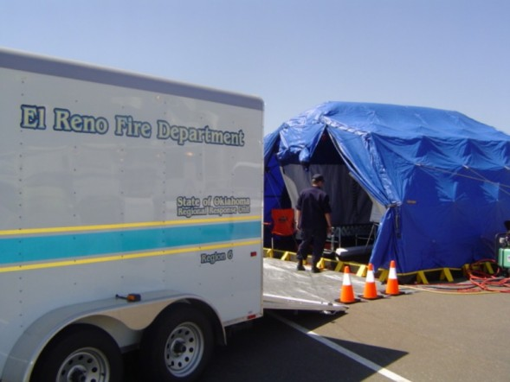
Hard Assets: Regional Response System (OKOHS)
(24) Small Decon Units
Shelter/Shower Tent
Generator

Slide 34
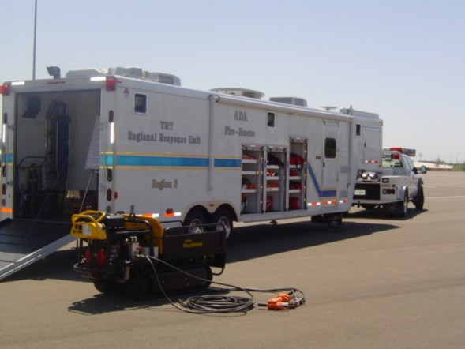
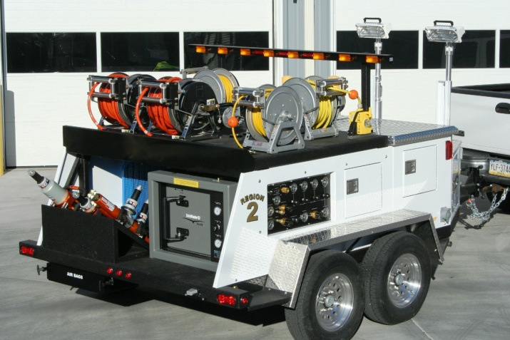
Hard Assets: Regional Response System (OKOHS)
(10) Technical Rescue Units
(13) Small Rescue Units
  Generators
  Cascade System
  Extrication Tools
  Light Towers

Slide 35
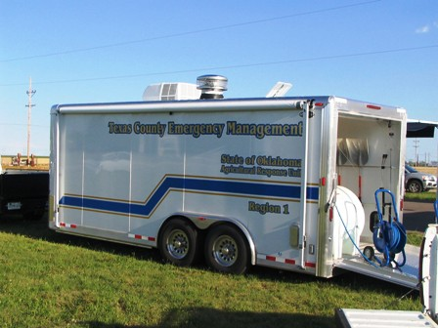
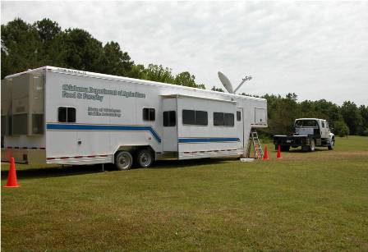
Hard Assets: Regional Response System (OKOHS)
(8) Agricultural Response Units
(1) Mobile Agricultural Laboratory
  Clean animals and investigate animal disease outbreak
  State Dept. of Agriculture

Slide 36
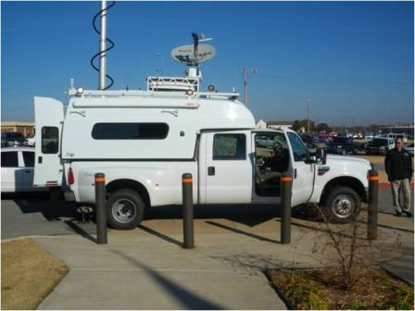
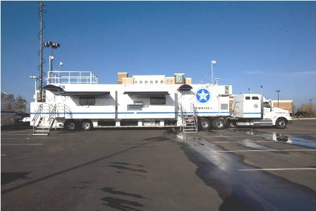
Hard Assets: Regional Response System (OKOHS)
(2)Command Units
Command One
  Full Command Post
  Radio Bridging Equipment
  Internet
Command Two
  4X4 Chassis
  Radio Bridging
  Area Internet

Slide 37
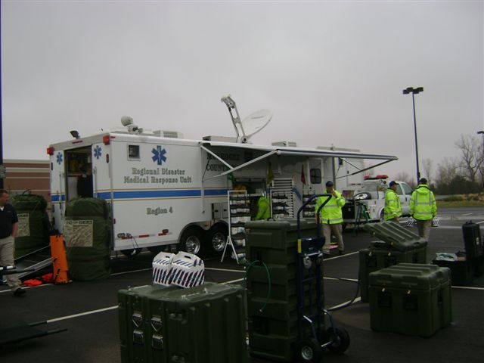
Hard Assets: Regional Response System (OKOHS)
Regional Emergency Medical Service System (REMSS)
(2) Large Trailers
  200 patients
  Oxygen generation
  Oxygen cascade
  Lights/Generator
  Command Post
  Satellite and Internet

Slide 38
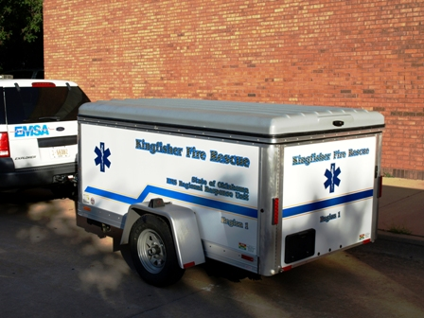
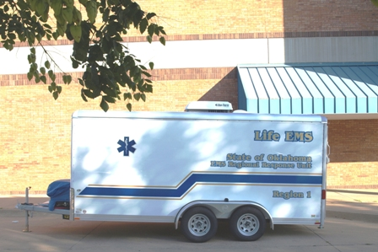
Hard Assets: Regional Response System (OKOHS)
Regional Emergency Medical Service System (REMSS)
(14) Medium
  75-100 Patients
  Generator/Temp Controlled
  72 hour Ops
(15) Bantam
  25 patients
  Pulled by any vehicle

Slide 39
How it May Play Out…
Rule #1: Oklahoma Likely Not Affected
Rule #5: Impact States Start with Significant Response along with Federal Assets
Rule #2: Some Self-Dispatch—later regretted
Rule # 3: Oklahoma begins slow and organized assessment and response—slow by design, but too slow and selective for people at first…
Rule #4: Oklahomans Go to Help—any way they can
Rule #7: Refugees/Patients Stream into Oklahoma
Rule #6: Nation sends overwhelming response

Slide 40
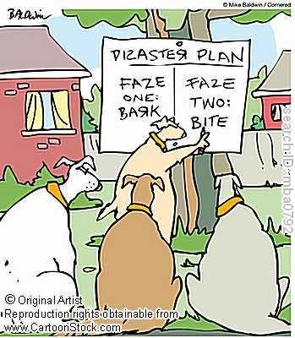
Questions
Michael Murphy
MMRS Director
Emergency Medical Services Authority
1111 Classen Drive
Oklahoma City, Oklahoma 73103
405-297-7059
murphym@emsa.net

